Slide 1

HARD WORK ALWAYS PAYS OFF
Trusted by 9K + Clients

Slide 2
ABOUT TINY JOBS
Since 2020
We have 8k + happy clients
Trusted platform to earn through mobile and laptop
It is Work from home job
Can earn the amount through daily basis or weekly basis
Withdraw done through GPAY,PHONPEY,PAYTM & also through direct transfer to the bank account
Contact Info
Can contact through – Whatsapp,email,and also Instagram
Whatsapp – 8778619227 , 8248579717
Email ID – tinyjobs6@gmail.com
Instapage – tiny_jobse
https://linktr.ee/Tinyjobse -- can also connect through this link
Website - https://www.tinyjobse.com/

Slide 3
Job opening
We are hiring for Work From Home
Qualifications- 12 th to Any graduation
Work with your LAPTOP or SMART PHONE with Proper network connection
Work timing – at your free time , no stress and no target
Freshers also welcome
College students , house makers, are welcome
There is no age Limit , Need to be more then 18 years

Slide 4

99 JOBS
For more details follow the below link:
https://youtu.be/ArO8hG3hiik?si=tn_8ZlutUKMmZTdc

Slide 5

GAME JOBS
For more details follow the below link:
https://youtu.be/bqbrkLf9NNg?si=E9tkmjdfu4zsgkVU

Slide 6

TYPING CAPTCHA
For more details follow the below link:
https://youtu.be/VgqUnyUMSeA?si=u3jBaqMATEQZaqbg

Slide 7
Hiiiii Welcome bro/ sis
❤Hearty welcome to TinyjobseWork from home 🏡DETAILS ABOUT US
👇This job is under google(Support by 2captcha) 4.9⭐/5⭐
Job la join pana enatha oru Qualifications hu thevaila Android mobile / lap irutha pothum (Not supported for iOS ) yaru vena work panala
👉Intha work 2captcha apdindra app la pannanum athula ungaluku dollars la thaa payment tharuvaanga atha neenga direct ah withdraw pannamudiyaathu..Naanglae withdraw panni unga Account ku send panniduvom,without any commition...Per captcha ku 0.001$ kidaikum 1 usd vantha withdraw pannikilaamNormal captcha/Recaptcha Points differ akum ✅💯 0.0001 for Normal Captcha ...1k+ Captcha enter panaunu
👉So 499rs charge pandrom..life time fulla neenga earn panni withdraw pannikilaam.(NON REFUNDABLE AMOUNT)

Slide 8
👉 PAYMENT METHODNengha earn pandra amount yelamey gpay , phonepe , Paytm la nangha send panidhuvom ...
👉DAILY WITHDRAWNengha earn pandra amount dailyu withdraw panikala MINIMUM WITHDRAW 1$=85-90Rs
👉NO LIMITATIONS FOR CAPTCHA * There is no limitations * no target * 24×7work panni earn panlam * Free time job
👉 PER DAY HOW MUCH U CAN EARN ? Athu neenga spend pandra time poruthu thaan iruku..evolo time spend pandringalo athuku ethamaari earnings kidaikum..if you work hard you earn more
👉Minimum amount to withdraw?Neenga 1$ (USD) earn pantu sonna pothum naangala withdraw panni kuduthuduvom 1usd=85Rs
👉NO NEED TO PAY ANY AMOUNT Initial 499rs thavara ethuvum eppovum katta thevailla

Slide 9
👉 JOINING PROCEDUREJoin panna enna pannanum 499rs pay pannitu SCREENSHOT send pannuga And unga mail id correct ah kudunga.
.❤Easy ah earn panala 1 time investment withdraw pandra variku nangha help panuvo nabi join panala 💯nangha gurantey nengha earn pana Page 1 year ah run aytu iruku 😍must see our highlights for demo video and payment proof 🤗🤗⬇➡
Dice captcha / Authenticate captcha / Recaptcha/ number Captcha all u should verify
Any doubts please ask 🙏 welcome

Slide 10
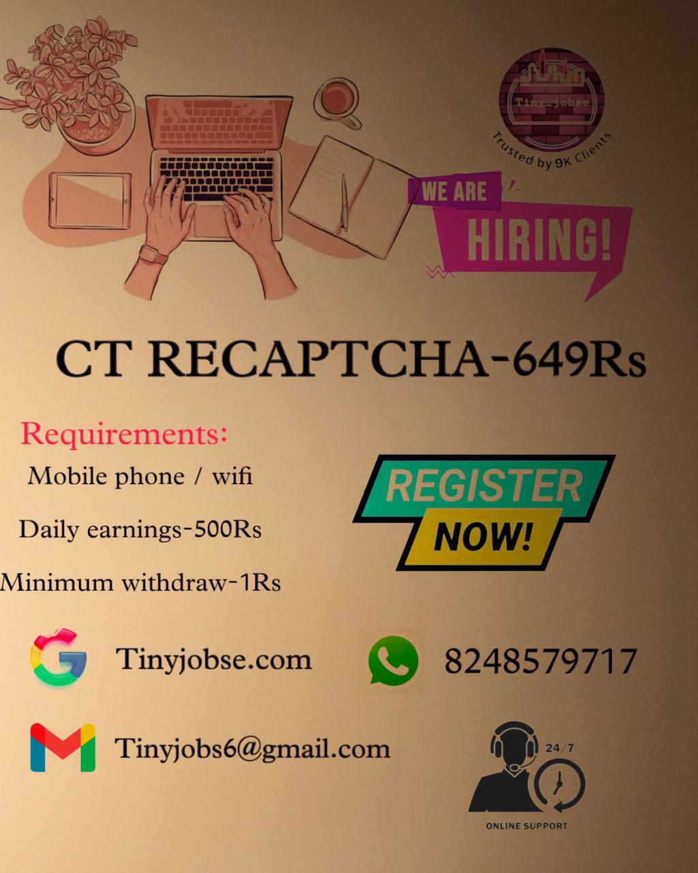
CT RECAPTCHA
For more details follow the below link:
https://youtu.be/R_YLWue6lIk?si=2Cv8KQW6jRJlEZcX

Slide 11

TINY TRADE
For more details follow the below link:
https://youtu.be/YwVoRk16Naw?si=PQdDyfnTq7qaF0q1

Slide 12

TINY PROJECT
For more details follow the below link:
https://youtu.be/T0AK7UAtuX4?si=rRzvUJt7ClGENPcs
https://youtu.be/seCnfCpFHR8?si=5LEmDkP5MB_JVp5t

Slide 13
WHO CAN JOIN IN PROJECT?
ELIGIBILITY FOR RT PROJECT:
Must Complete Degree
Well and Good English Knowledge
Good Internet connection
Laptop / System must

Slide 14
ABOUT THE PROJECT
Earn in $USD doing online tasks from home
Do tasks, get paid. It’s that simple
From labelling images to transcribing audio, earn money completing simple tasks
Training will be provided in the project itself
After completing each training course , task will open which will pay you money
For correct task only money will be paid
We will transfer your earned money to your account in Indian rupees.

Slide 15
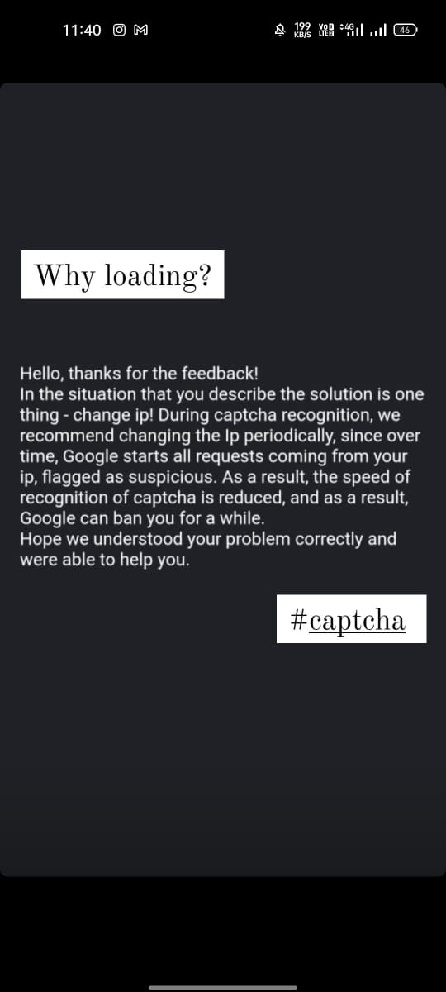
Important Note:
Captcha loading depends on your Network Speed only.

Slide 16
4. CRYPTO TYPING
Typing job is very easy , You can earn through by typing or by using Recaptcha.
You can claim daily 100 words then like ptc view can claim all work which is similar to this .
For withdraw there is 3 steps.
Full Crypto currency based work, so Minimum payout 500 Rs kita.
The earn amount should be all in Cryptocurrency, So no need to worry for the withdraw.
Click the below link to watch crypto typing demo video
https://youtu.be/da_uvMvkAO8

Slide 17
Note: Crypto Typing
Minimum withdrawal 30-60 doge coin
For Withdraw it take some time because its crypto currency based earning.
Your own Pan card and Aadhar card must needed while joining crypto typing.

Slide 18
5.MINNING
This is the most easy work that ever you can seen .
There is no work need to be done , only thing need to active all 2 hours once.
Dollars will be adding to your account by activating 2 hours once.
After receiving 15 usd withdraw can be done.

Slide 19
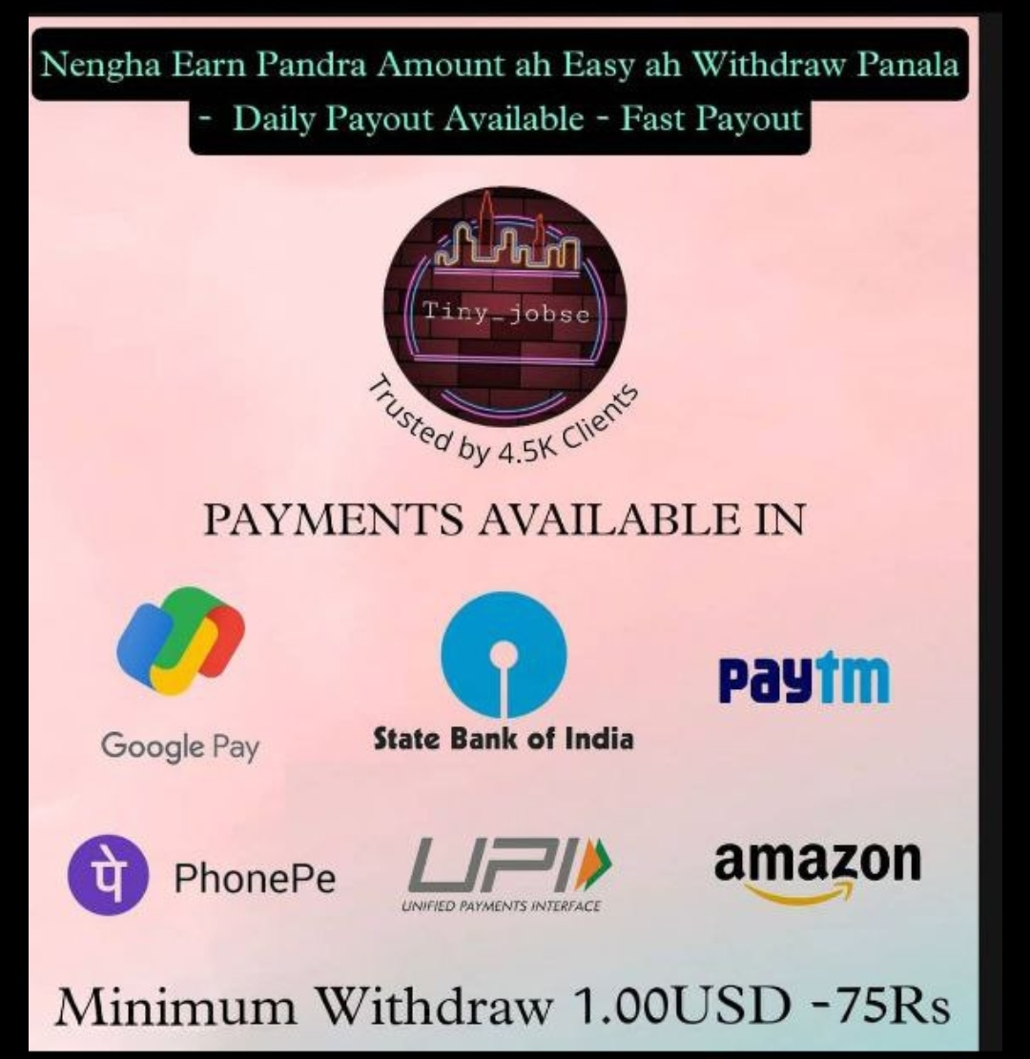
PAYMENT DETAILS
UPI ID : 8682815300@hdfcbank Gpay : 8682815300 No registration fees we only asking dollar exchange fees for lifetime withdraw process Once joint in one job package we can’t change to any other jobs. If need any other job need to take that package for joining . For other work Joining Rs.100 / Rs.50 Can’t pay . Only package is available for joining the work.

Slide 20
Important Note:
Age limit should be above 18 years
Once after starting the work can earn . So need good knowledge and daily work capacity.
We need only interested people who can work daily with dedication.
Minimum 1 dollar can earn , can ping in Insta page with in 24 hours payment can be withdraw and transfer to your account – Fast payout ever in Instagram page.
PAYMENT withdraw proof for RT project, captcha , kol captcha, Typing, minning are given below.

Slide 21
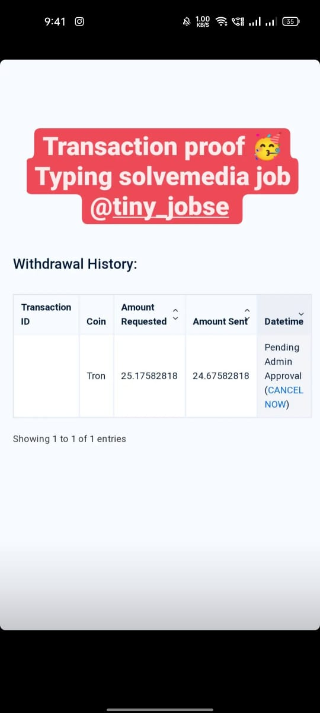
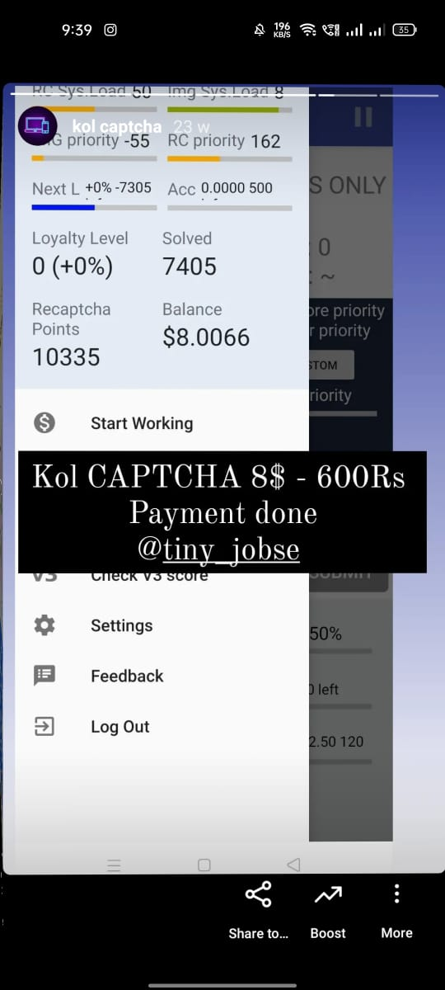
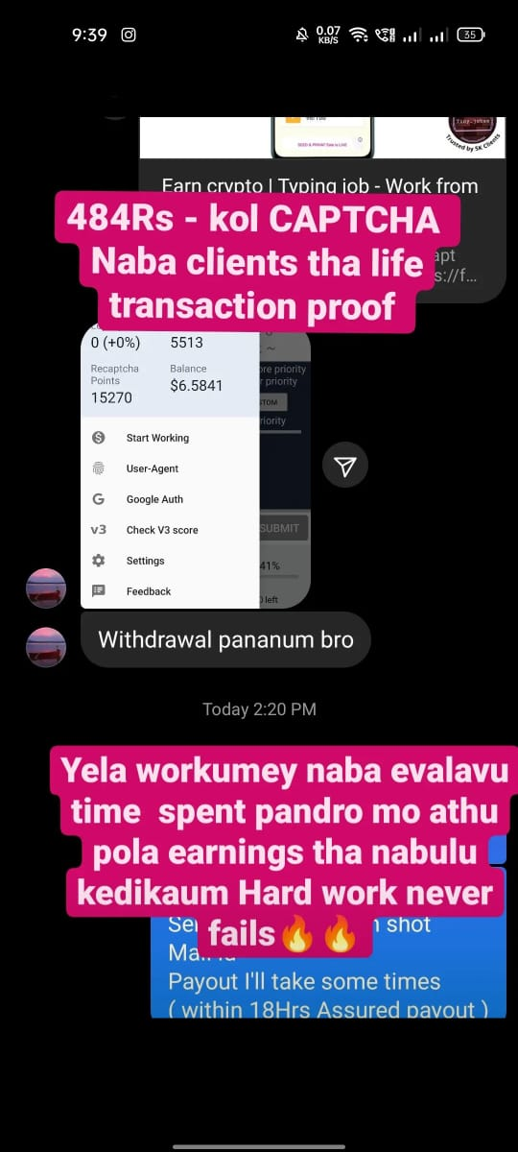
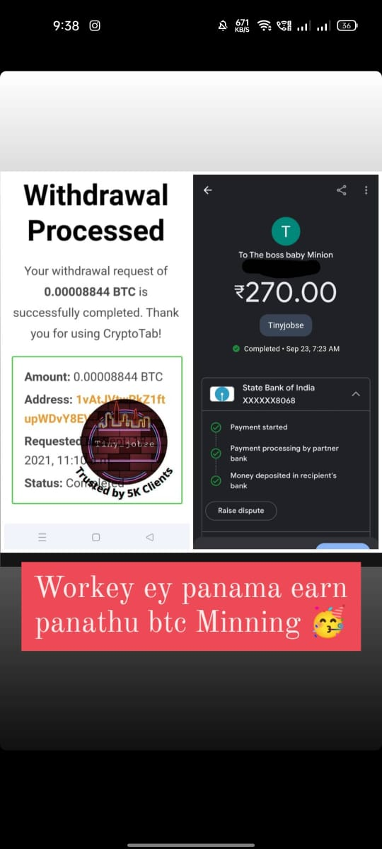
Payment withdraw proof

Slide 22
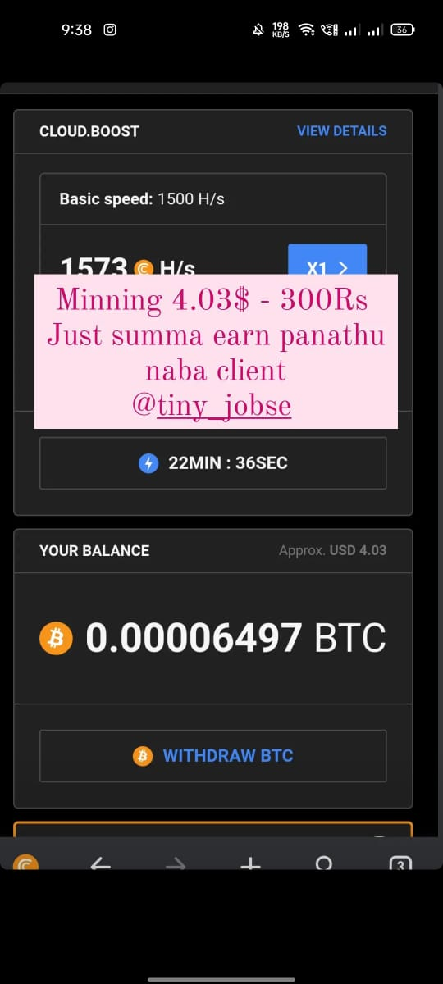
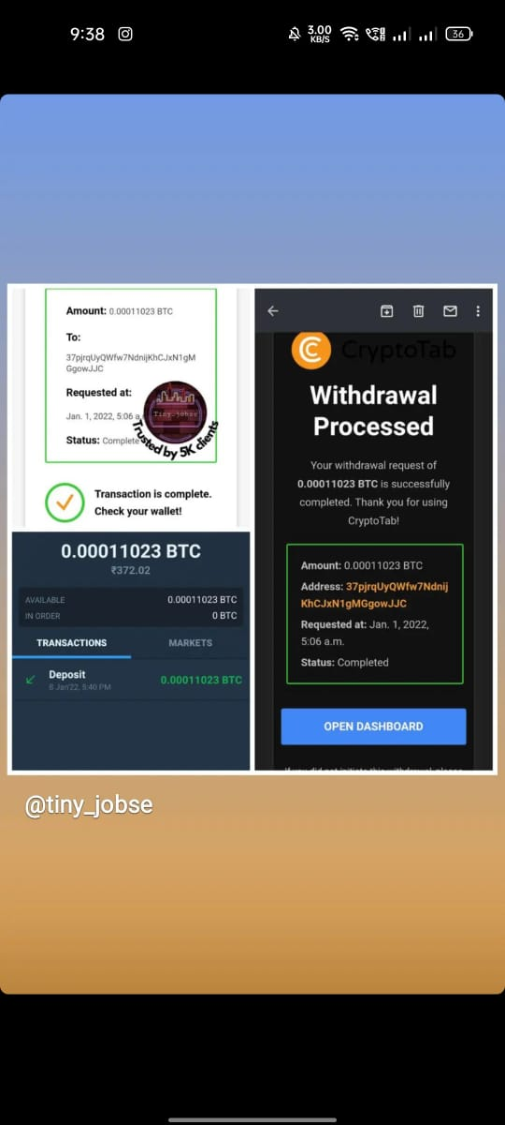

Slide 23
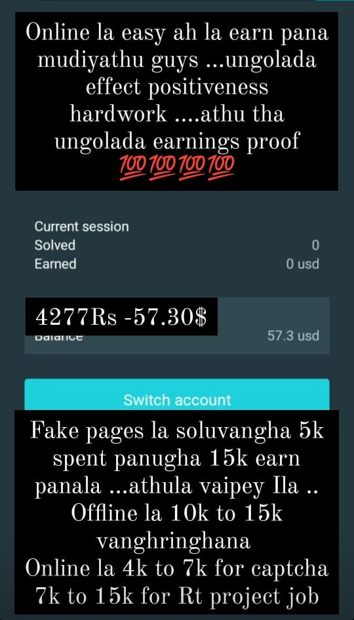
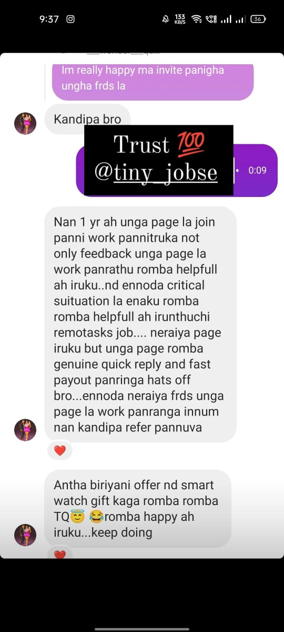
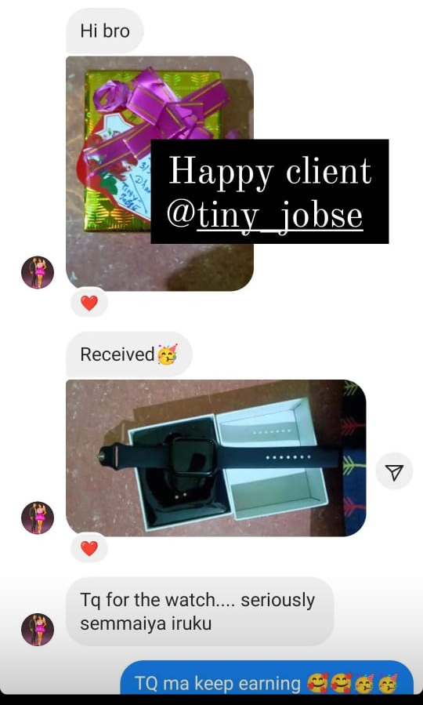
Feedbacks

Slide 24
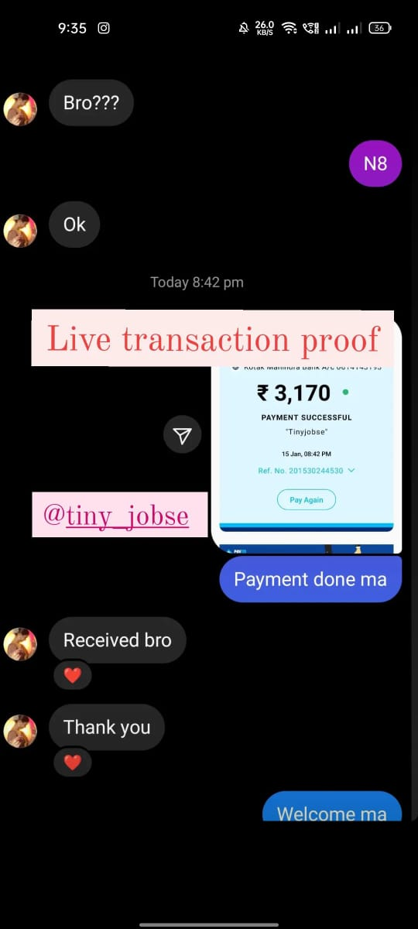
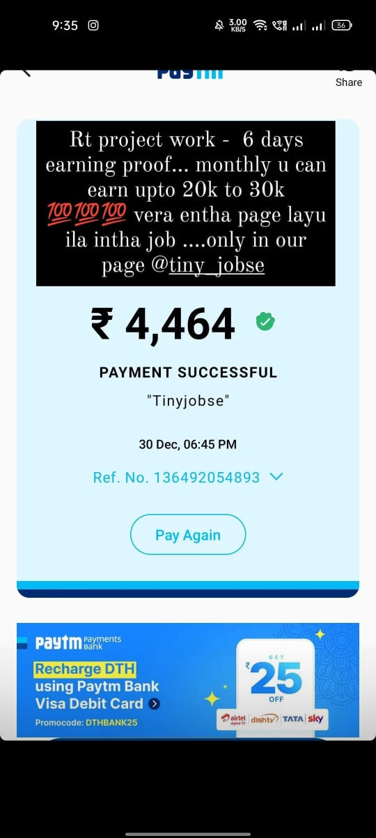
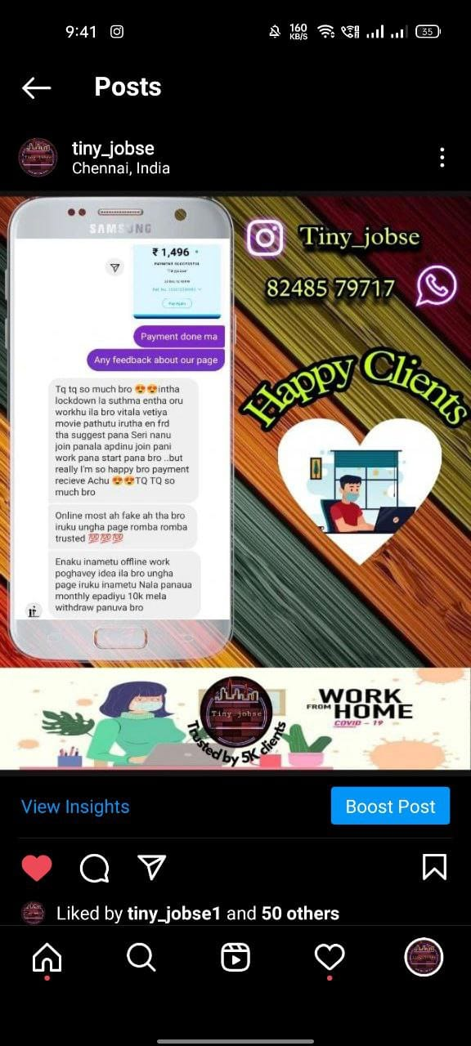
Live transaction proof and feedback

Slide 25
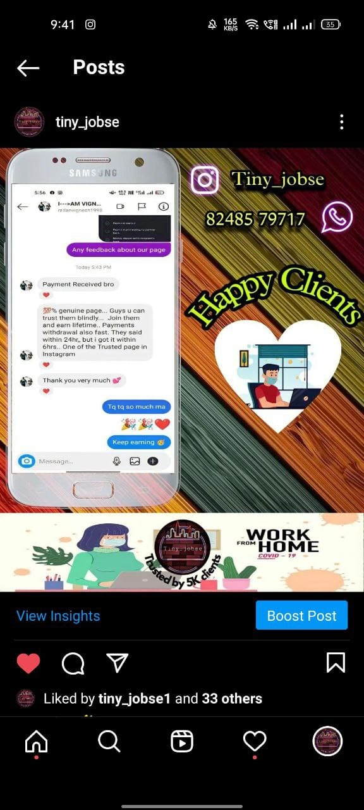
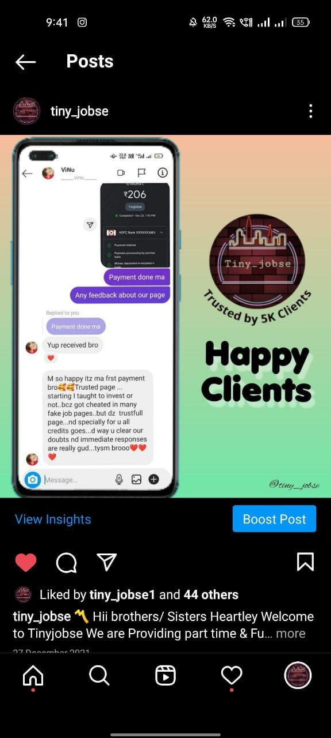
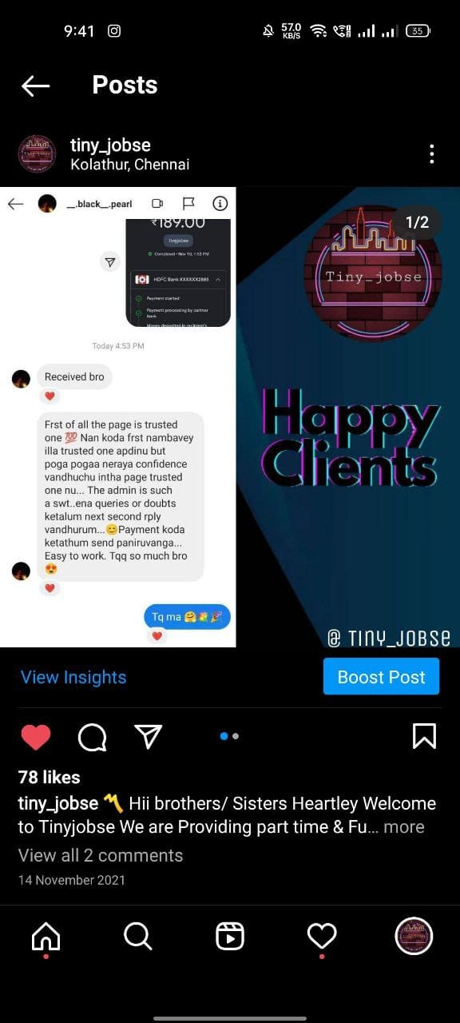

Slide 26
For more feedbacks and transaction proof check our instagram page highlights
Visit our website @
http://www.tinyjobse.weebly.com/
https://www.tinyjobse.com/
THANK YOU

